Slide 1
Modeling Magnetic Morphologies of Star-Forming Regions
Kenji Emerson
SMA-ASIAA/Akamai 2018

Slide 2
Presentation Overview
Overview
Theory
Modeling Observations
Implementation
Simulation Results
Summary
Overview
Theory of Magnetic Fields and Polarization
Modeling Observations
Implementation
Simulation Results
Summary

Slide 3
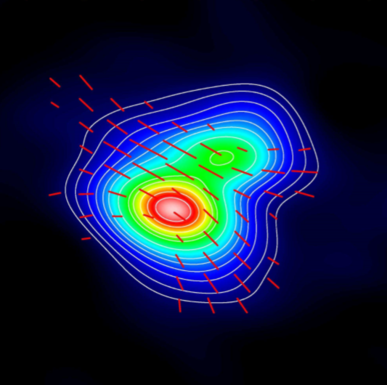
Importance of Magnetic Fields (B-fields)
Overview
Theory
Modeling Observations
Implementation
Simulation Results
Summary
Magnetic braking
Slows protoplanetary disk rotation, allowing for its collapse.
Cloud Support
Magnetic fields prevent the collapse of gas clouds below a specific critical mass.
Scattering
Magnetic field observations may be contaminated by scattering effects.
Girart, Rao, and Marrone 2006

Slide 4
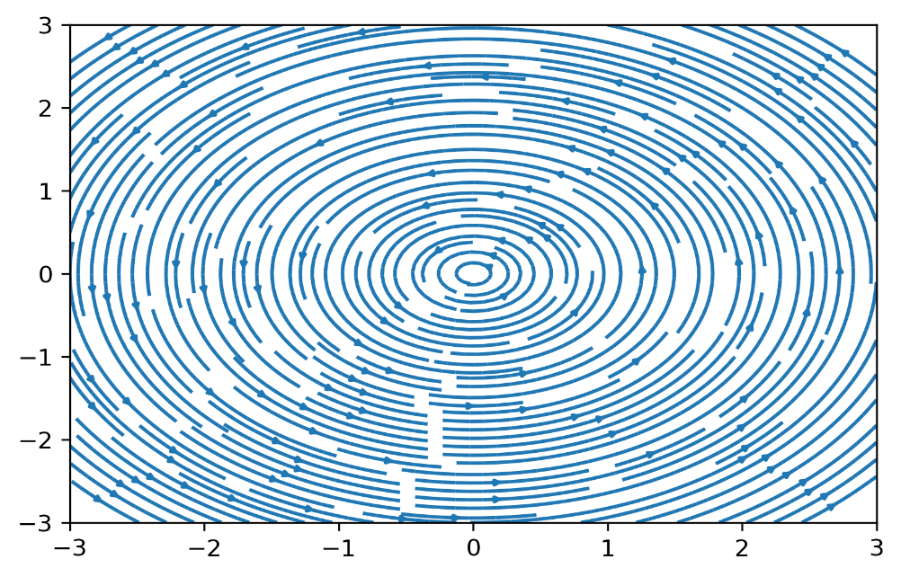
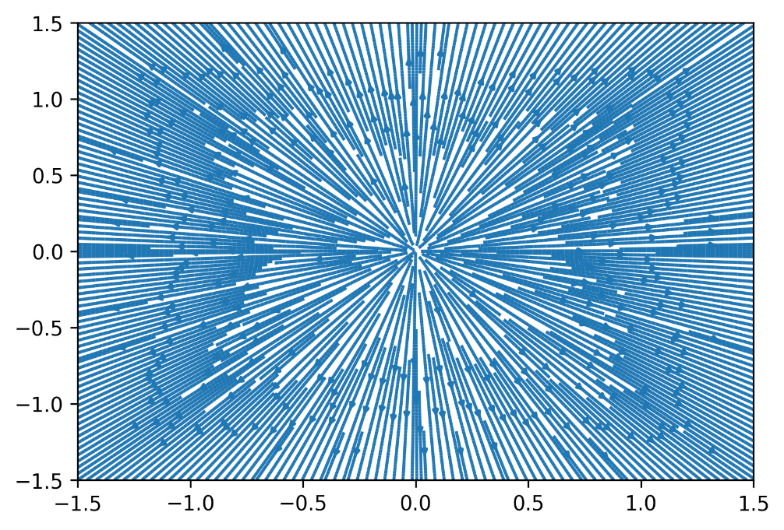
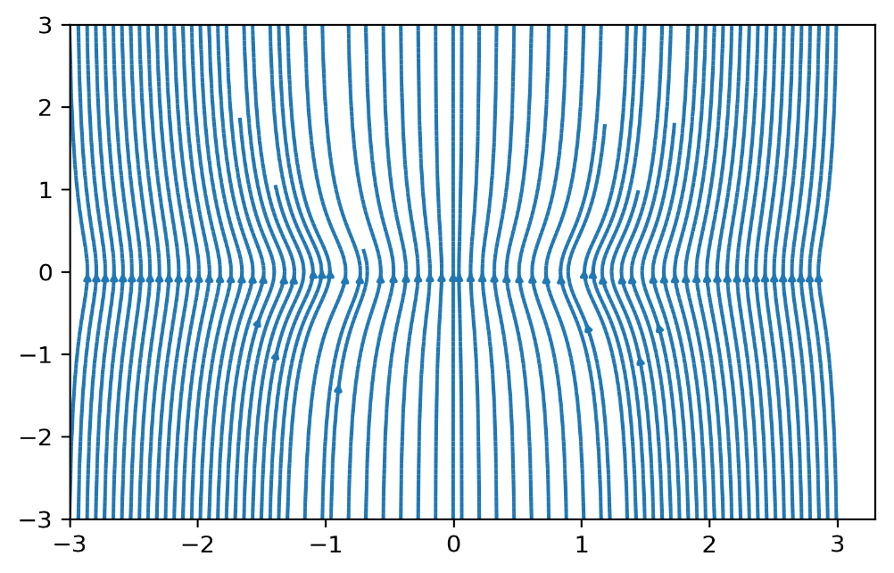
Modeling B-field Components
Overview
Theory
Modeling Observations
Implementation
Simulation Results
Summary
Circular
Monopole
Hourglass
Girart, Rao, and Marrone 2006

Slide 5
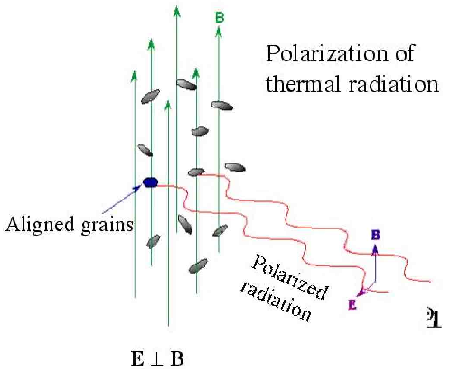
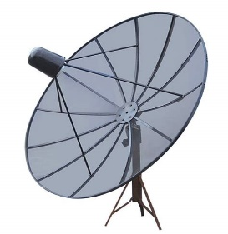
Determining B-fields via Dust & Polarization
Overview
Theory
Modeling Observations
Implementation
Simulation Results
Summary

Slide 6
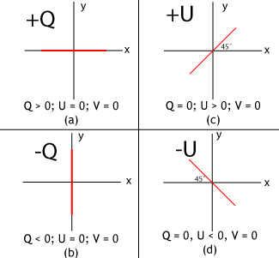

Stokes Parameters
Overview
Theory
Modeling Observations
Implementation
Simulation Results
Summary

Slide 7
Project Aims
Overview
Theory
Modeling Observations
Implementation
Simulation Results
Summary
Create an algorithm/program to simulate observations
Superpositions of common morphologies
Plots of major Stokes parameters (I,Q,U)
Customizable object and observing parameters
Object parameters:
Cloud geometry and density
Magnetic field and intensity
Polarization function
Sightline parameters:
Field-of-view and offset from protoplanetary cloud
Girart, Rao, and Marrone 2006

Slide 8
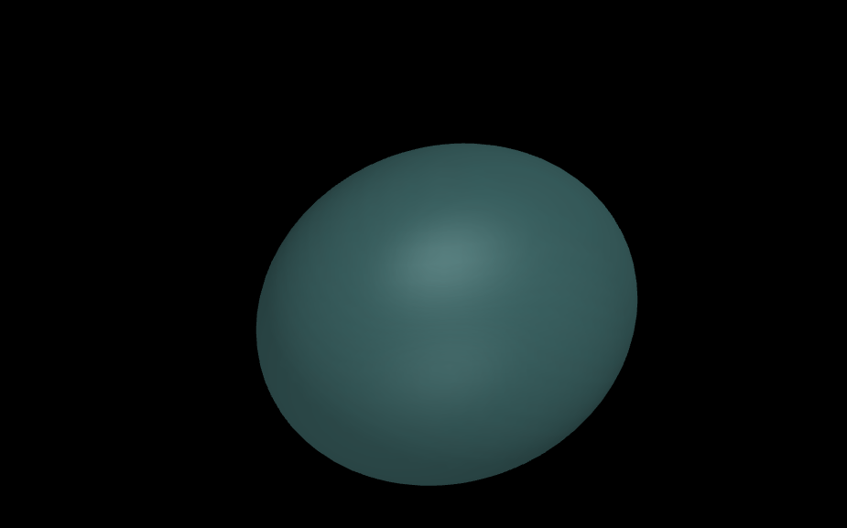
A Dust Cloud
Overview
Theory
Modeling Observations
Implementation
Simulation Results
Summary

Slide 9
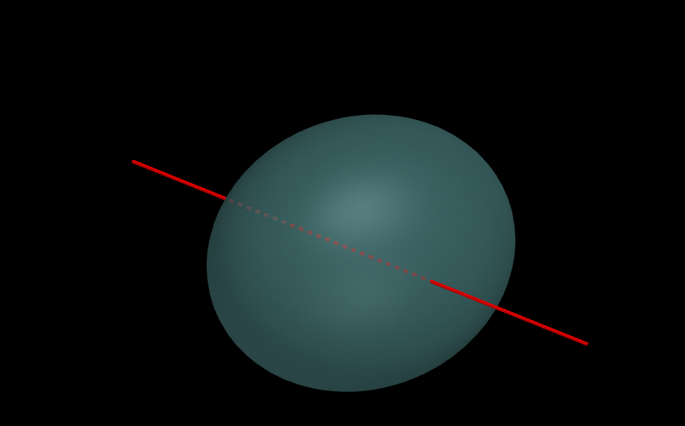
A Dust Cloud with a Sightline
Overview
Theory
Modeling Observations
Implementation
Simulation Results
Summary

Slide 10
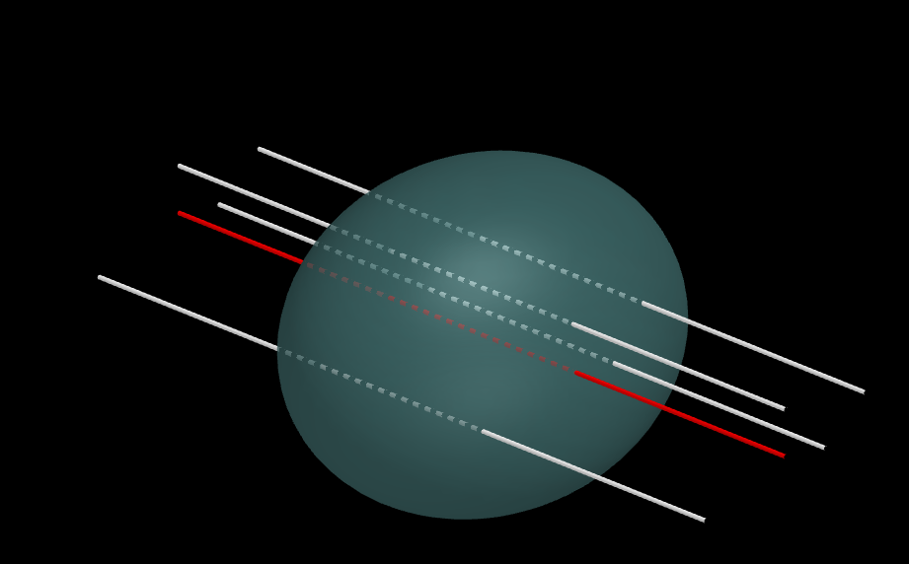
A Dust Cloud with Many Sightlines
Overview
Theory
Modeling Observations
Implementation
Simulation Results
Summary

Slide 11
Simulation Implementation Structure
Overview
Theory
Modeling Observations
Implementation
Simulation Results
Summary
ObservingRun
ProtostarModel
Magnetic Field
Density Profile
Sightline
Astropy SkyCoord
Cloud Geometry
Polarization Function
Astropy SkyCoord

Slide 12
ObservingRun Algorithm
Overview
Theory
Modeling Observations
Implementation
Simulation Results
Summary
Generate Sightline Grid
Uniform 2D y-z/RA-DEC grid of sightlines
Integrate Physical Values along Sightlines
Over all regions within the cloud
Over all functions/fields (intensity, magnetic, polarization)
Create Contour Plots for Stokes I,Q,U & Angle
Derive E-field from integrated B-field and intensity
Make appropriate colored contours, auto-scale color bars
Based on input field of view and primary sightline

Slide 13
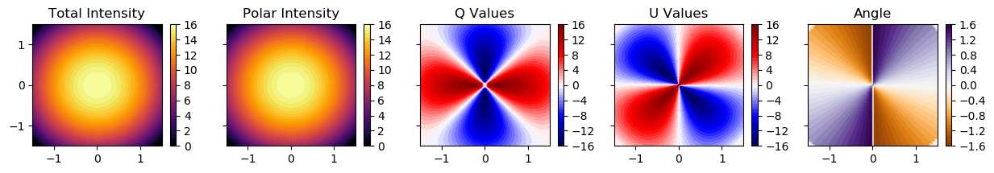

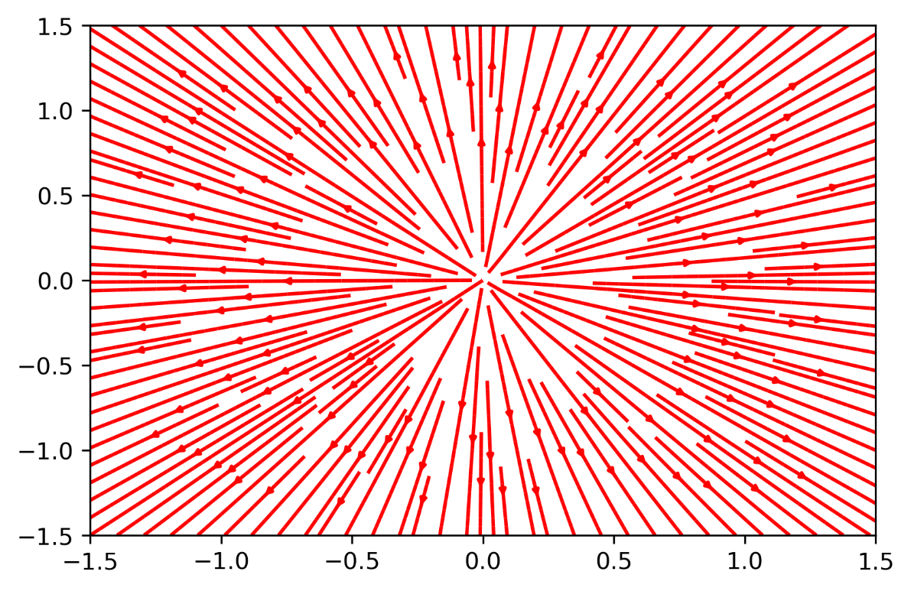
Results: Circular Field
Overview
Theory
Modeling Observations
Implementation
Simulation Results
Summary
B-field
E-field

Slide 14
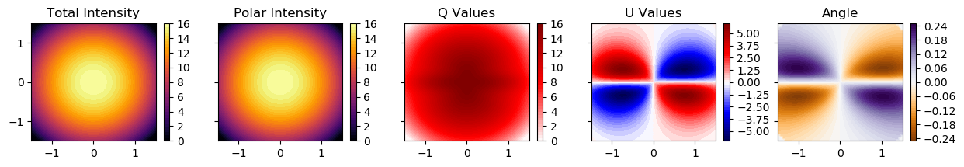
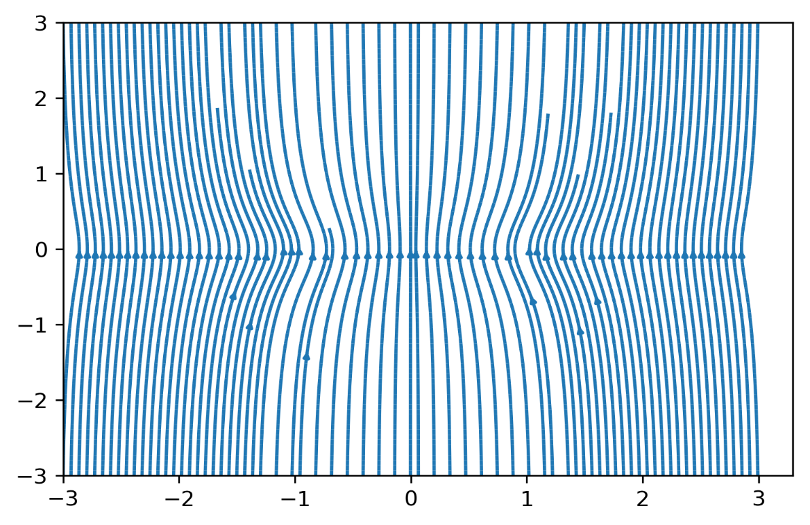
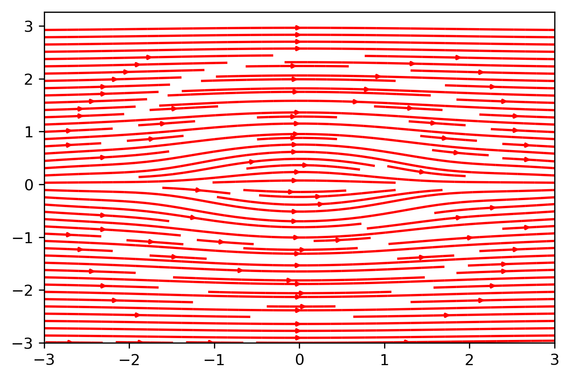
Results: Hourglass Field
Overview
Theory
Modeling Observations
Implementation
Simulation Results
Summary
B-field
E-field

Slide 15
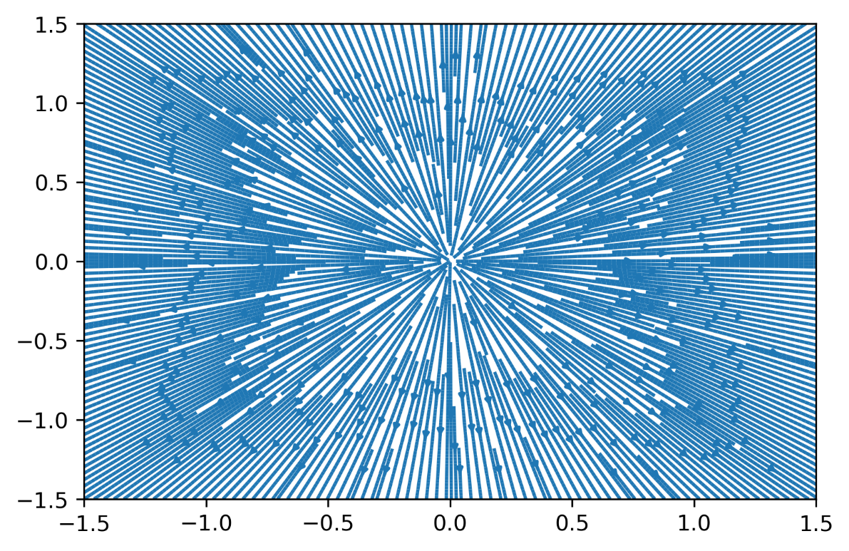
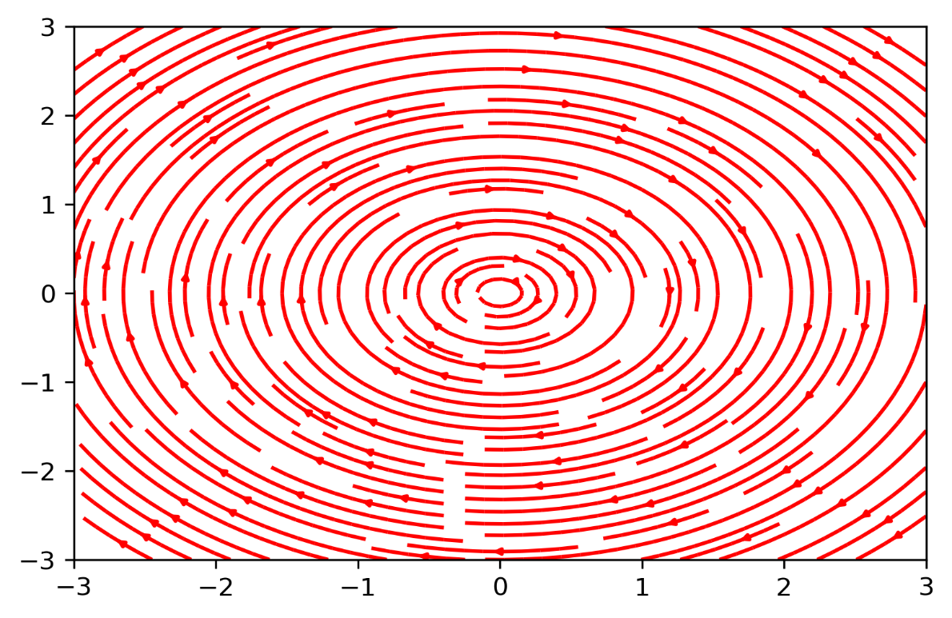
Results: Monopole Field
Overview
Theory
Modeling Observations
Implementation
Simulation Results
Summary
B-field
E-field

Slide 16
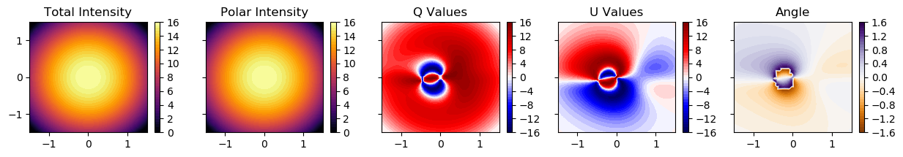

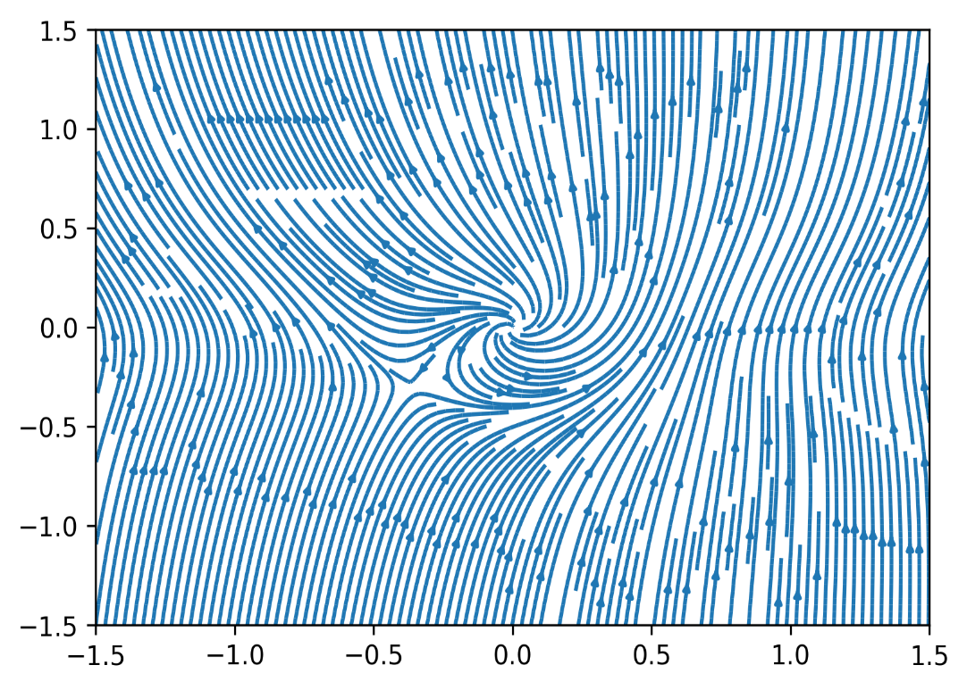
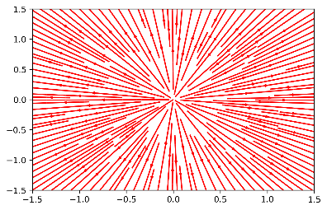
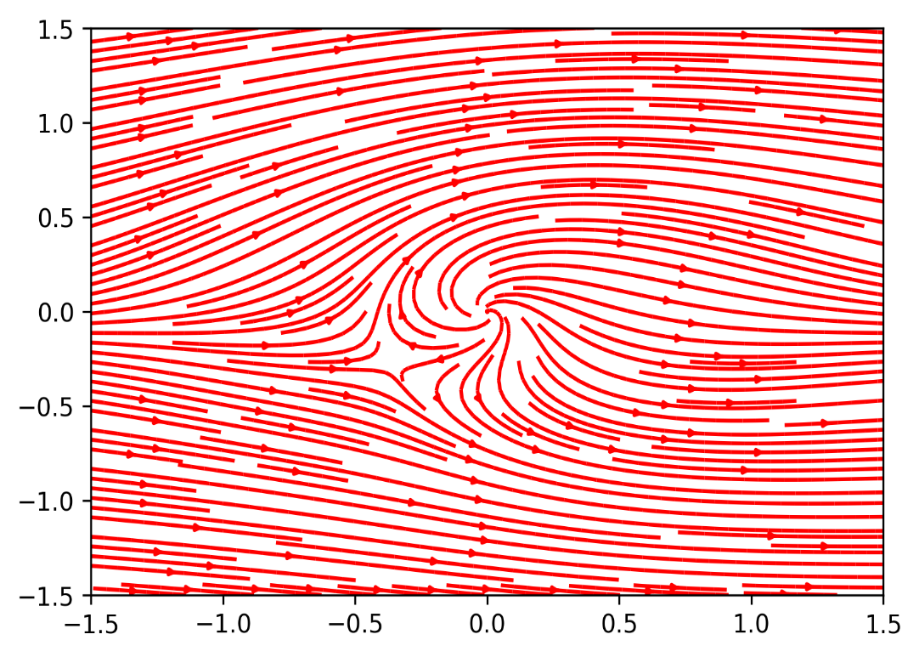
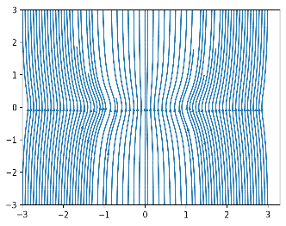
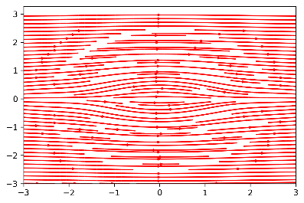

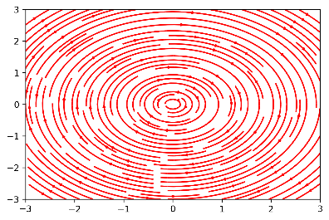
Results: Composite Field
Overview
Theory
Modeling Observations
Implementation
Simulation Results
Summary
B-field
E-field

Slide 17
Summary
Overview
Theory
Modeling Observations
Implementation
Simulation Results
Summary
The algorithm for polarization observations of different magnetic morphologies is functional.
Plots of I,Q,U values are logical and consistent.
Implementation is scalable and portable (using Python and Anaconda).
Source code is publicly available with documentation:
https://github.com/psmd-iberutaru/Akamai_Internship

Slide 18
Future Progress
Overview
Theory
Modeling Observations
Implementation
Simulation Results
Summary
Compare simulated models to real observed polarization data.
Test different combinations of the three magnetic fields.
Add new magnetic field functions.
Use different cloud shapes, density profiles, and polarization functions.

Slide 19
Acknowledgments
Smithsonian Submillimeter Array
Academia Sinica Institute of Astronomy and Astrophysics
Mentor: Ramprasad Rao
Akamai Workforce Initiative program
The Thirty Meter Telescope International Observatory
The Air Force Office of Scientific Research
Hawai‘i STEM Learning Partnership at Hawai'i Community Foundation
The Monty Richards Hawai'i Island – Bank of Hawai'i Foundation
The Daniel K. Inouye Solar Telescope
National Science Foundation
The University of Hawai'i at Hilo
Canada-France-Hawai'i Telescope

Slide 21
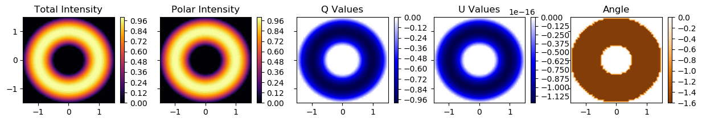
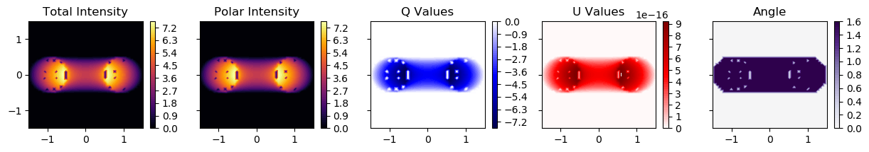
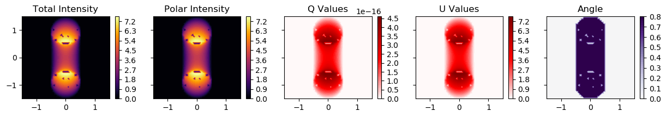
A Bit More Complex Geometries

